Slide 1
E-commerce Security and Payment Systems

Slide 2
The E-commerce Security Environment
Overall size and losses of cybercrime unclear
Reporting issues
2012 survey: Average annualized cost of cybercrime was $8.9 million/year
Underground economy marketplace:
Stolen information stored on underground economy servers

Slide 3
What Is Good E-commerce Security?
To achieve highest degree of security
New technologies
Organizational policies and procedures
Industry standards and government laws
Other factors
Time value of money
Cost of security vs. potential loss
Security often breaks at weakest link

Slide 4
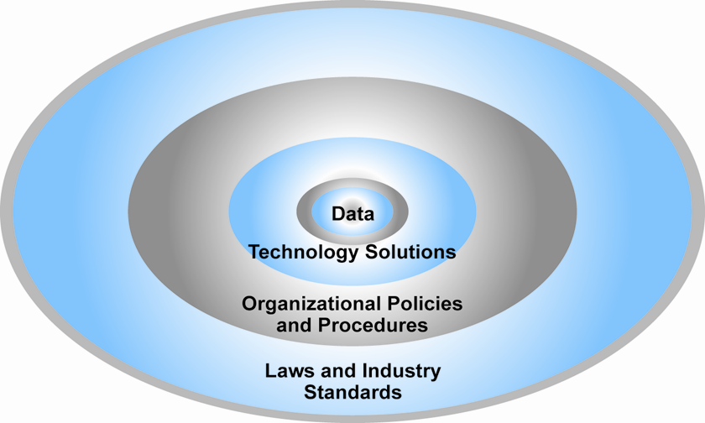
The E-commerce Security Environment

Slide 5
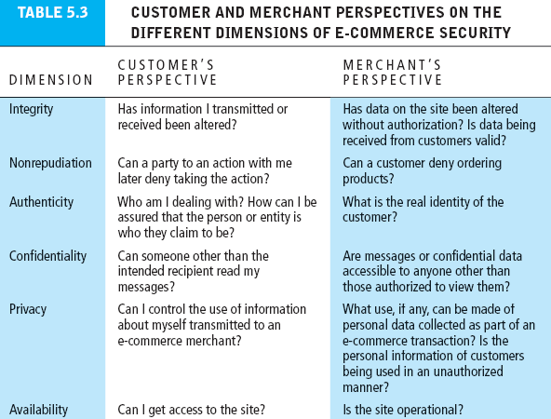

Slide 6
The Tension Between Security and Other Values
Ease of use
The more security measures added, the more difficult a site is to use, and the slower it becomes
Public safety and criminal uses of the Internet
Use of technology by criminals to plan crimes or threaten nation-state

Slide 7
Security Threats in the E-commerce Environment
Three key points of vulnerability in e-commerce environment:
Client
Server
Communications pipeline (Internet communications channels)

Slide 8
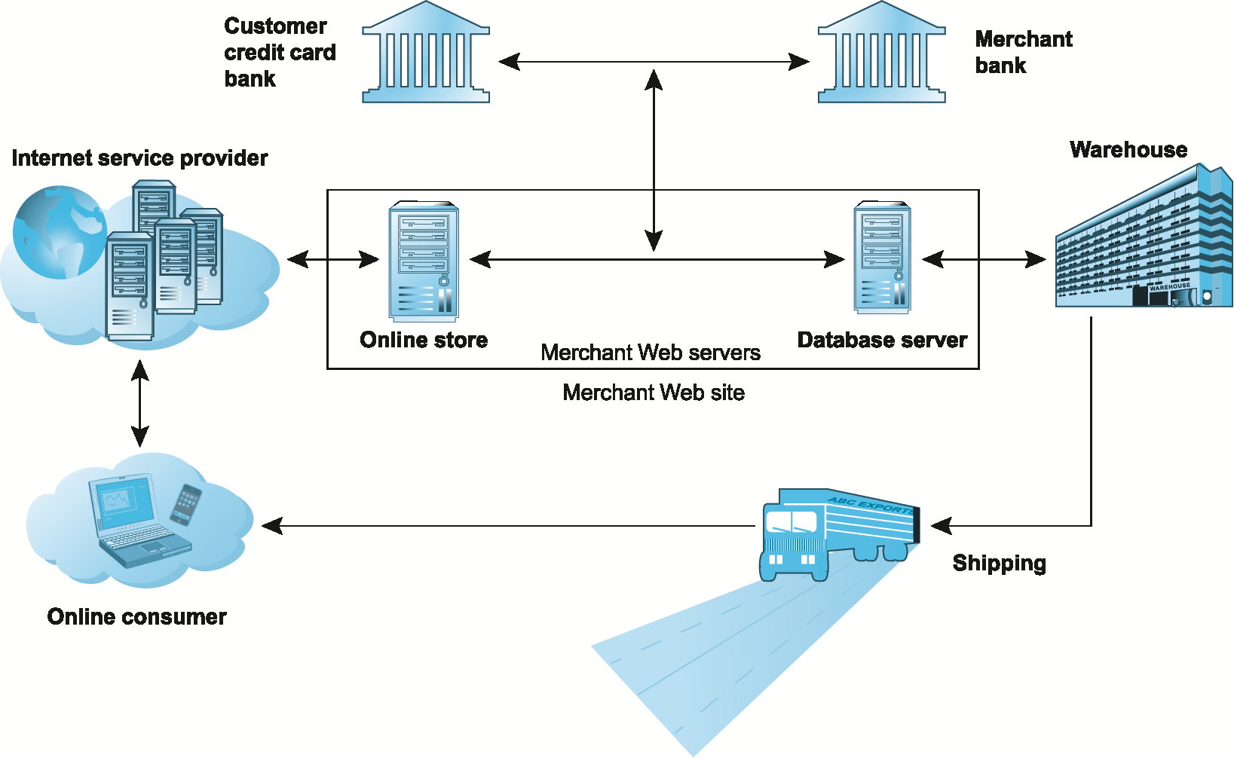
A Typical E-commerce Transaction

Slide 9
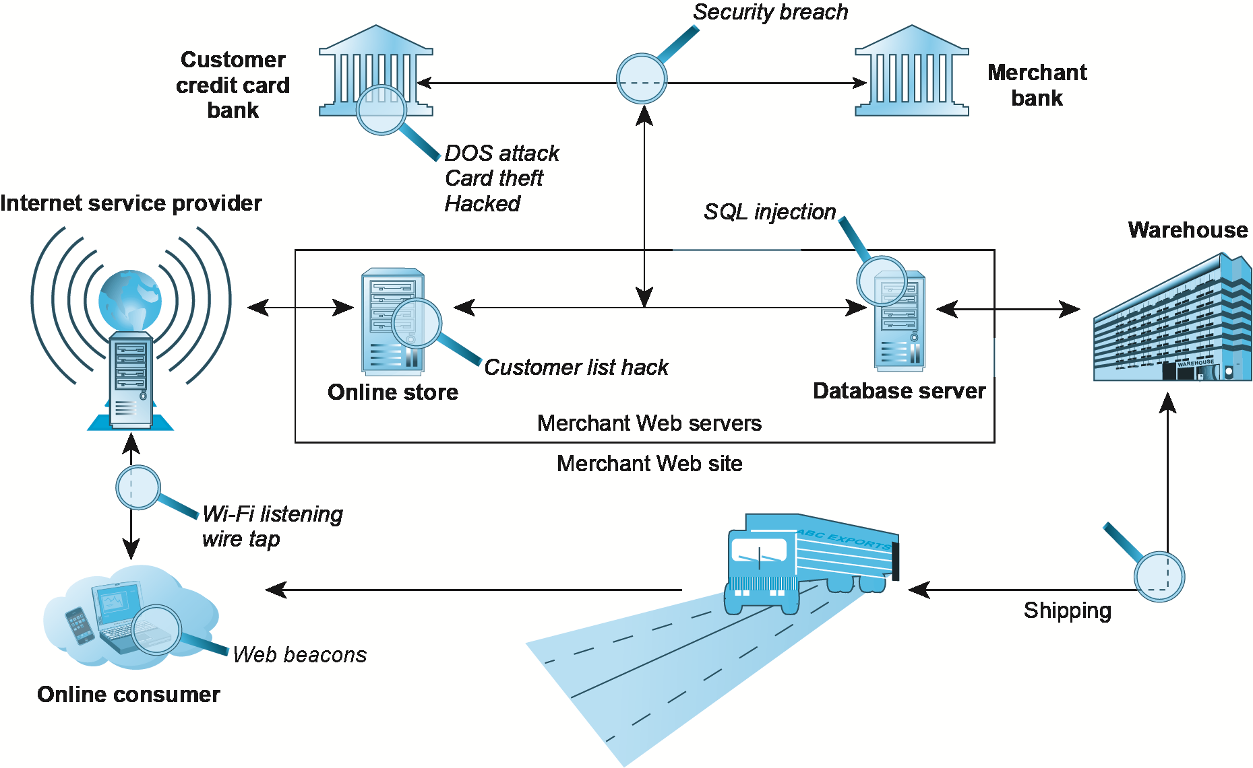
Vulnerable Points in an E-commerce Transaction

Slide 10
Most Common Security Threats in the E-commerce Environment
Malicious code (malware, exploits)
Drive-by downloads
Viruses
Worms
Ransomware
Trojan horses
Backdoors
Bots, botnets
Threats at both client and server levels

Slide 11
Most Common Security Threats (cont.)
Potentially unwanted programs (PUPs)
Browser parasites
Adware
Spyware
Phishing
Social engineering
E-mail scams
Spear-phishing
Identity fraud/theft

Slide 12
Most Common Security Threats (cont.)
Hacking
Hackers vs. crackers
Types of hackers: White, black, grey hats
Hacktivism
Cybervandalism:
Disrupting, defacing, destroying Web site
Data breach
Losing control over corporate information to outsiders

Slide 13
Most Common Security Threats (cont.)
Credit card fraud/theft
Spoofing and pharming
Spam (junk) Web sites (link farms)
Identity fraud/theft
Denial of service (DoS) attack
Hackers flood site with useless traffic to overwhelm network
Distributed denial of service (DDoS) attack

Slide 14
Most Common Security Threats (cont.)
Sniffing
Eavesdropping program that monitors information traveling over a network
Insider attacks
Poorly designed server and client software
Social network security issues
Mobile platform security issues
Vishing, smishing, madware
Cloud security issues

Slide 15
Technology Solutions
Protecting Internet communications
Encryption
Securing channels of communication
SSL, VPNs
Protecting networks
Firewalls
Protecting servers and clients

Slide 16
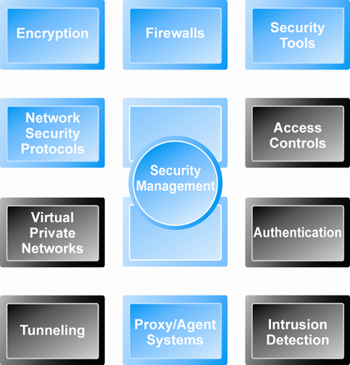
Tools Available to Achieve Site Security

Slide 17
Encryption
Encryption
Transforms data into cipher text readable only by sender and receiver
Secures stored information and information transmission
Provides 4 of 6 key dimensions of e-commerce security:
Message integrity
Nonrepudiation
Authentication
Confidentiality

Slide 18
Symmetric Key Encryption
Sender and receiver use same digital key to encrypt and decrypt message
Requires different set of keys for each transaction
Strength of encryption
Length of binary key used to encrypt data
Data Encryption Standard (DES)
Advanced Encryption Standard (AES)
Most widely used symmetric key encryption
Uses 128-, 192-, and 256-bit encryption keys
Other standards use keys with up to 2,048 bits

Slide 19
Public Key Encryption
Uses two mathematically related digital keys
Public key (widely disseminated)
Private key (kept secret by owner)
Both keys used to encrypt and decrypt message
Once key used to encrypt message, same key cannot be used to decrypt message
Sender uses recipient’s public key to encrypt message; recipient uses private key to decrypt it

Slide 20
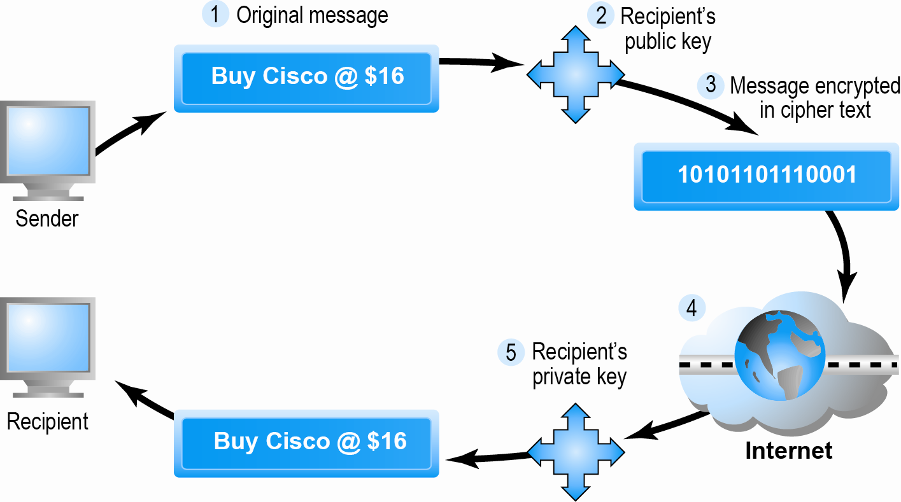
Public Key Cryptography: A Simple Case

Slide 21
Public Key Encryption using Digital Signatures and Hash Digests
Hash function:
Mathematical algorithm that produces fixed-length number called message or hash digest
Hash digest of message sent to recipient along with message to verify integrity
Hash digest and message encrypted with recipient’s public key
Entire cipher text then encrypted with recipient’s private key—creating digital signature—for authenticity, nonrepudiation

Slide 22
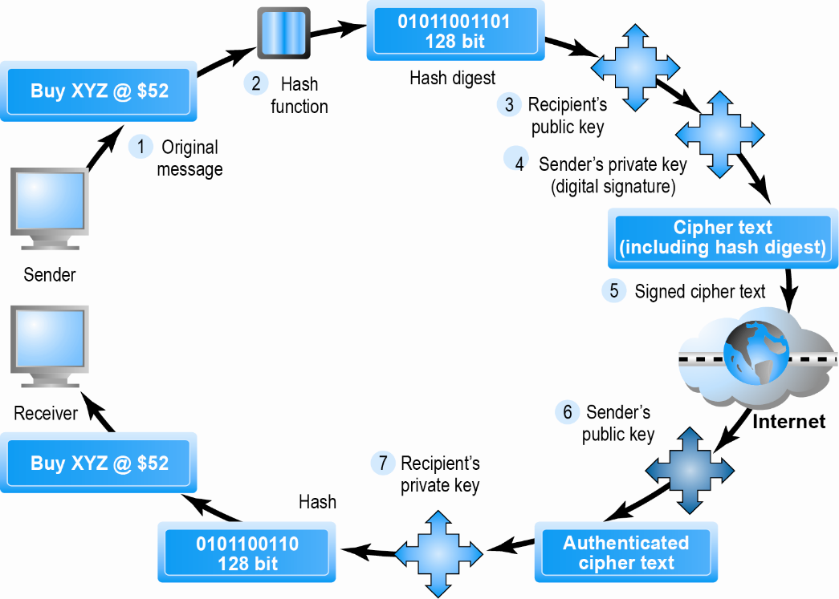
Public Key Cryptography with Digital Signatures

Slide 23
Digital Envelopes
Address weaknesses of:
Public key encryption
Computationally slow, decreased transmission speed, increased processing time
Symmetric key encryption
Insecure transmission lines
Uses symmetric key encryption to encrypt document
Uses public key encryption to encrypt and send symmetric key

Slide 24
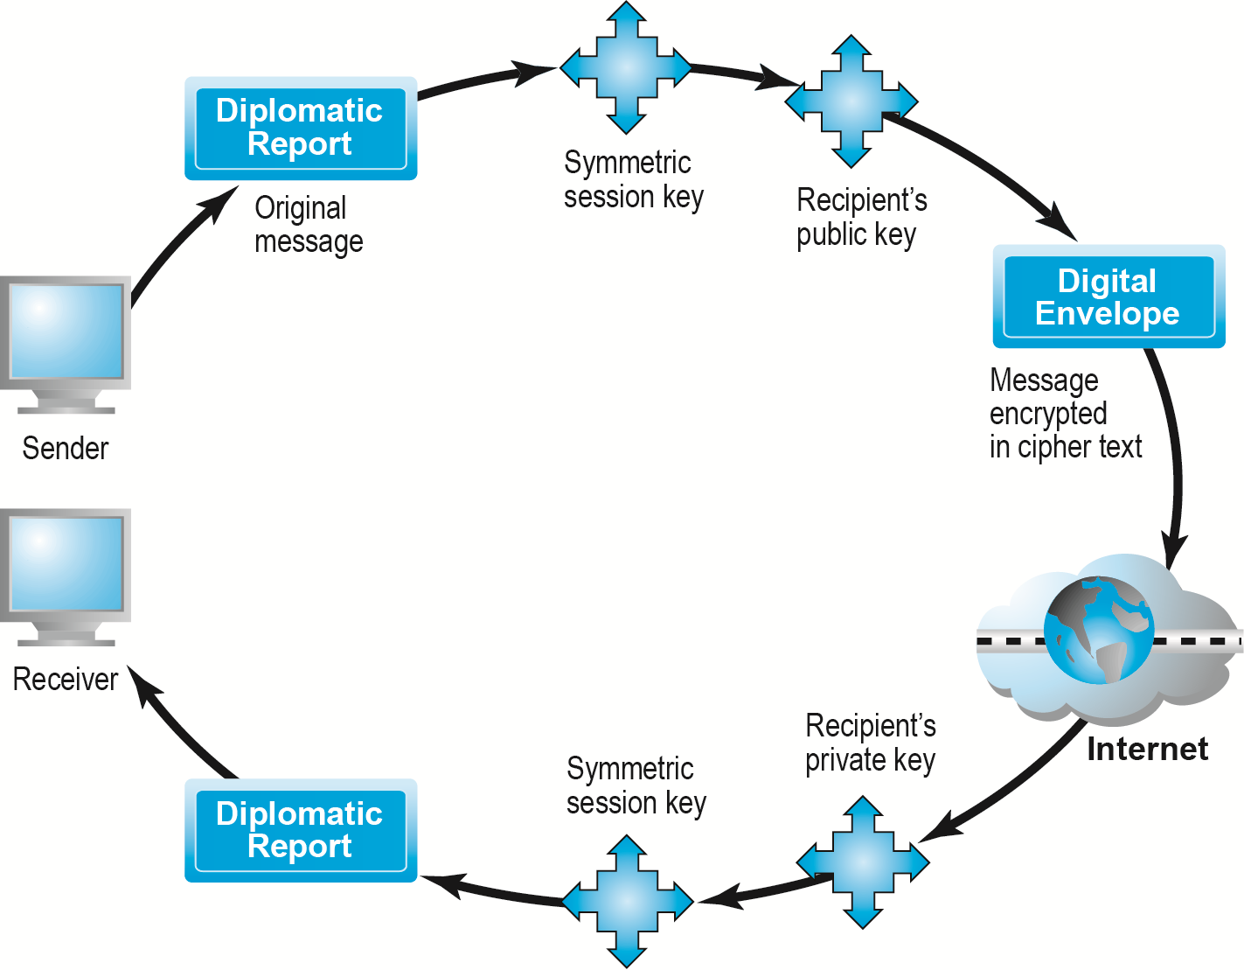
Creating a Digital Envelope

Slide 25
Digital Certificates and Public Key Infrastructure (PKI)
Digital certificate includes:
Name of subject/company
Subject’s public key
Digital certificate serial number
Expiration date, issuance date
Digital signature of CA
Public Key Infrastructure (PKI):
CAs and digital certificate procedures
PGP

Slide 26
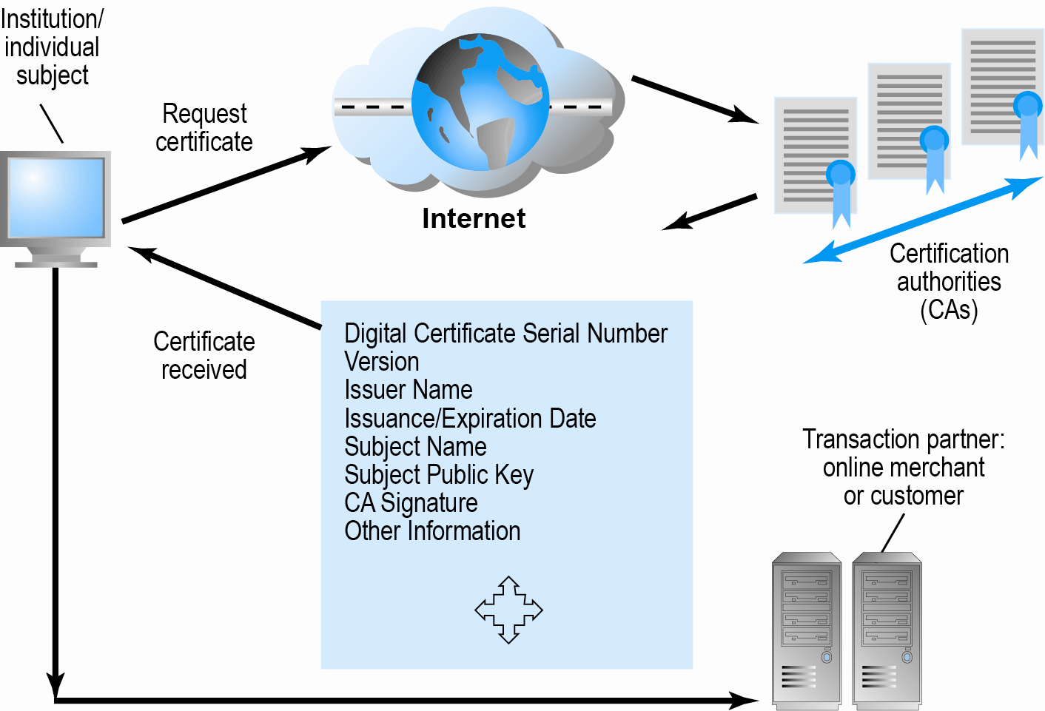
Digital Certificates and Certification Authorities
Figure 5.9, Page 283

Slide 27
Limits to Encryption Solutions
Doesn’t protect storage of private key
PKI not effective against insiders, employees
Protection of private keys by individuals may be haphazard
No guarantee that verifying computer of merchant is secure
CAs are unregulated, self-selecting organizations

Slide 28
Securing Channels of Communication
Secure Sockets Layer (SSL)/Transport Layer Security (TLS)
Establishes secure, negotiated client–server session
Virtual Private Network (VPN)
Allows remote users to securely access internal network via the Internet
Wireless (Wi-Fi) networks
WPA2

Slide 29
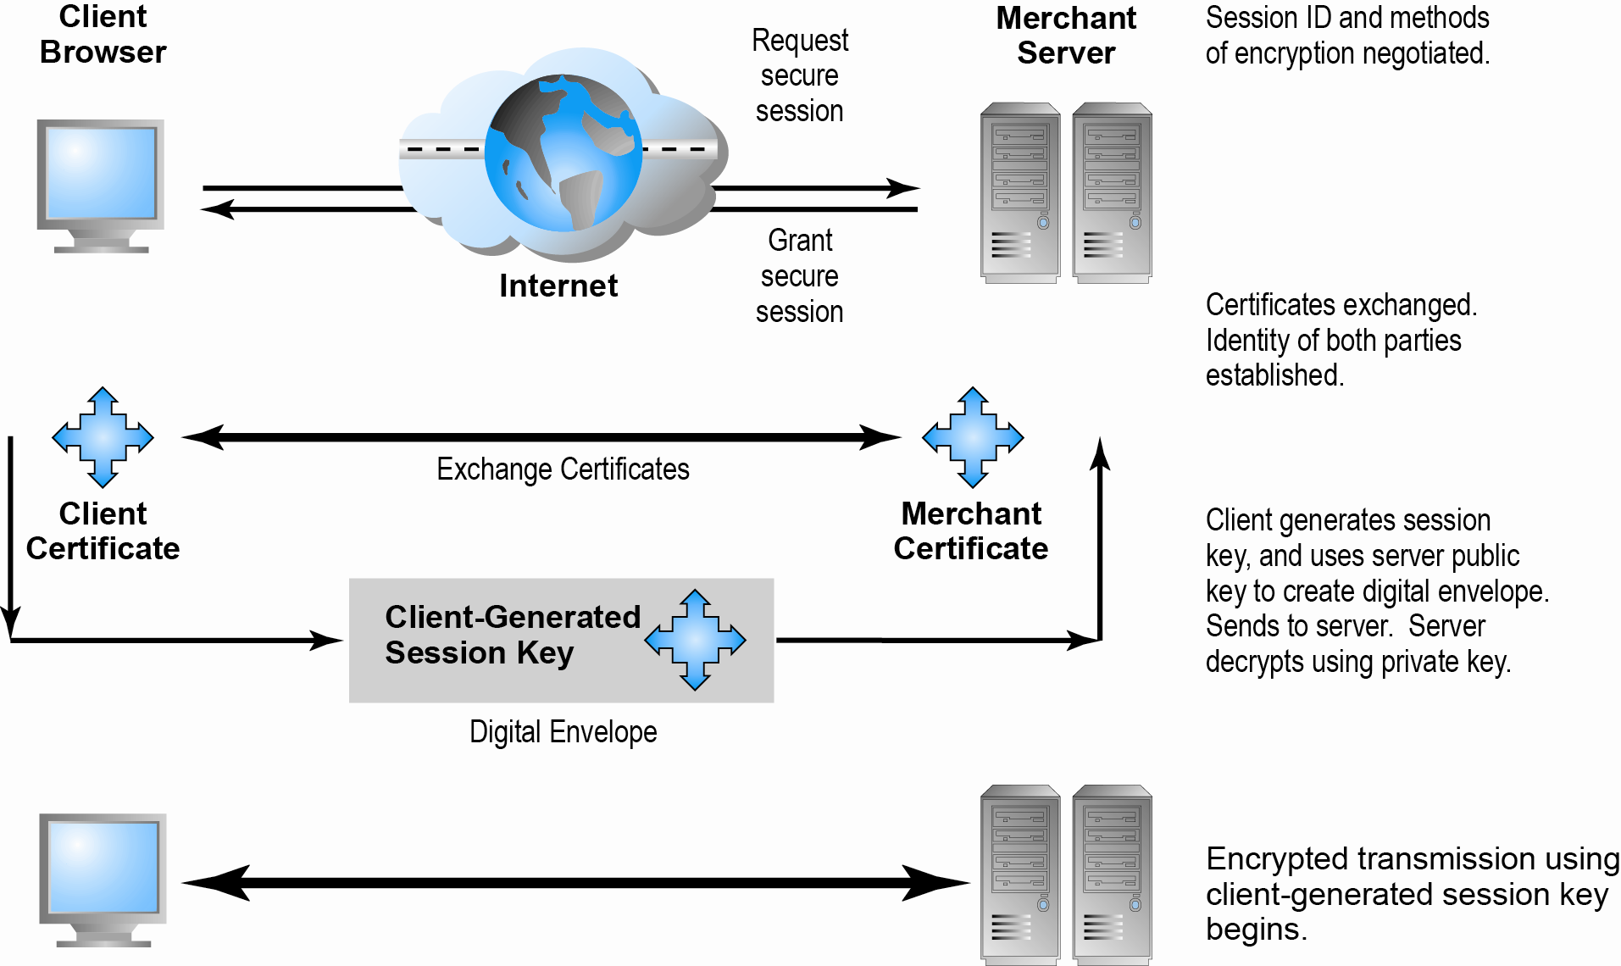
Secure Negotiated Sessions Using SSL/TLS
Figure 5.10, Page 286

Slide 30
Protecting Networks
Firewall
Hardware or software
Uses security policy to filter packets
Two main methods:
Packet filters
Application gateways
Proxy servers (proxies)
Software servers that handle all communications from or sent to the Internet
Intrusion detection systems
Intrusion prevention systems

Slide 31
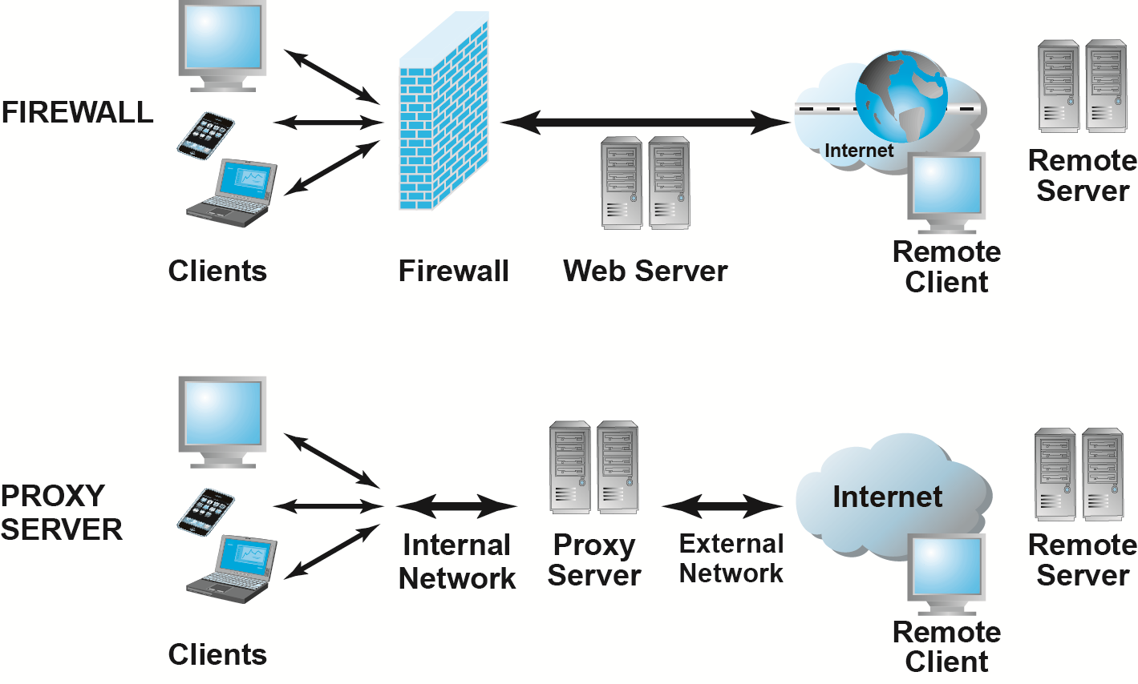
Firewalls and Proxy Servers

Slide 32
Protecting Servers and Clients
Operating system security enhancements
Upgrades, patches
Anti-virus software
Easiest and least expensive way to prevent threats to system integrity
Requires daily updates

Slide 33
Management Policies, Business Procedures, and Public Laws
Worldwide, companies spend more than $65 billion on security hardware, software, services
Managing risk includes:
Technology
Effective management policies
Public laws and active enforcement

Slide 34
A Security Plan: Management Policies
Risk assessment
Security policy
Implementation plan
Security organization
Access controls
Authentication procedures, including biometrics
Authorization policies, authorization management systems
Security audit

Slide 35
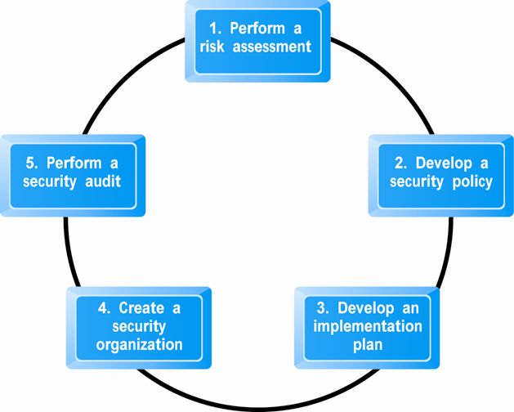
Developing an E-commerce Security Plan

Slide 36
The Role of Laws and Public Policy
Laws that give authorities tools for identifying, tracing, prosecuting cybercriminals:
Computer crime proclamation (No. 958/2016)
National payment system proclamation (No. 718/2011)
Electronic Transaction proclamation (No. 1205/2020)
Anti-Terrorism proclamation (No. 652/2009)
Telecom Fraud Offences proclamation (No. 761/2012)
Registration of Vital Events and National Identity Card proclamation (No. 760/2012)
Private and private-public cooperation
Ethiopia’s National digital payments strategy (2021-24)
Government policies and controls on encryption software
OECD, G7/G8, Council of Europe, Wassener Arrangement

Slide 37
Types of Payment Systems
Cash
Most common form of payment
Instantly convertible into other forms of value
No float
Check transfer
Credit card
Credit card associations
Issuing banks
Processing centers

Slide 38
Types of Payment Systems (cont.)
Stored value
Funds deposited into account, from which funds are paid out or withdrawn as needed
Debit cards, gift certificates
Peer-to-peer payment systems: venmo
Accumulating balance
Accounts that accumulate expenditures and to which consumers make period payments
Utility, phone

Slide 39
Payment System Stakeholders
Consumers
Low-risk, low-cost, refutable, convenience, reliability
Merchants
Low-risk, low-cost, irrefutable, secure, reliable
Financial intermediaries
Secure, low-risk, maximizing profit
Government regulators
Security, trust, protecting participants and enforcing reporting

Slide 40
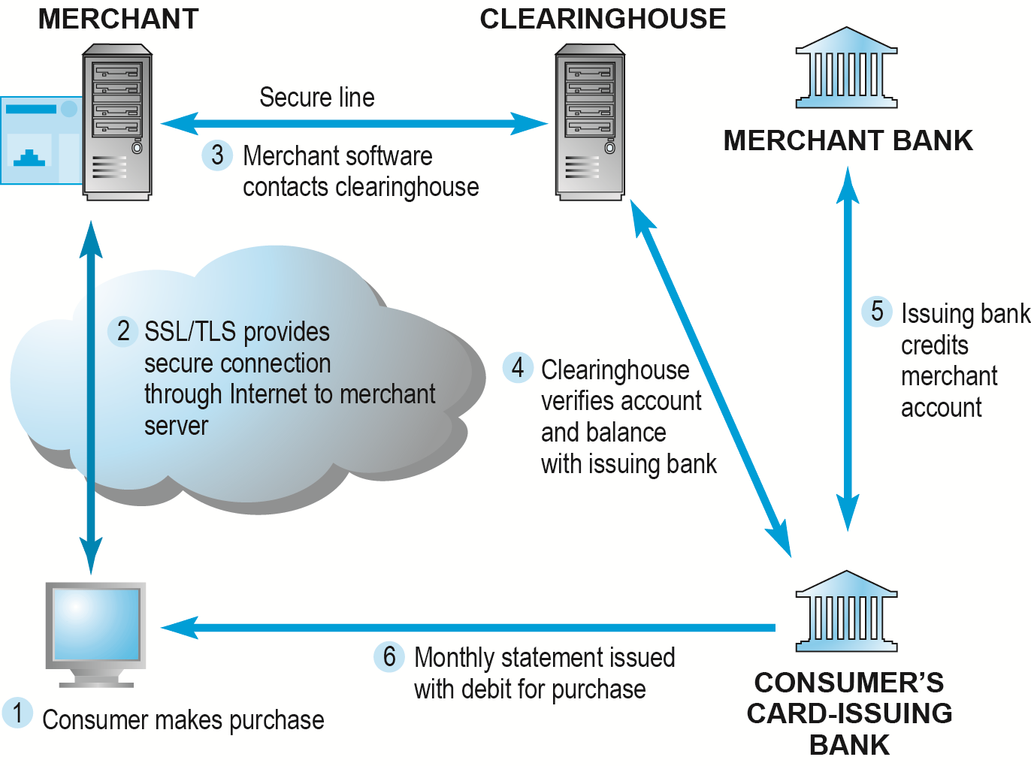
How an Online Credit Transaction Works
Figure 5.15, Page 302

Slide 41
Alternative Online Payment Systems
Online stored value systems:
Based on value stored in a consumer’s bank, checking, or credit card account
Example: PayPal
Other alternatives:
Amazon Payments
Google Checkout
Bill Me Later
WUPay, Dwolla, Stripe

Slide 42
Mobile Payment Systems
Use of mobile phones as payment devices established in Europe, Japan, South Korea
Near field communication (NFC)
Short-range (2”) wireless for sharing data between devices
Others
Google Wallet
Mobile app designed to work with NFC chips
PayPal
Square

Slide 43
Digital Cash and Virtual Currencies
Digital cash
Based on algorithm that generates unique tokens that can be used in “real” world
Example: Bitcoin
Virtual currencies
Circulate within internal virtual world
Example: Linden Dollars in Second Life, Facebook Credits

Slide 44
Electronic Billing Presentment and Payment (EBPP)
Online payment systems for monthly bills
50% of all bill payments
Two competing EBPP business models:
Biller-direct (dominant model)
Consolidator
Both models are supported by EBPP infrastructure providers

